Slide 1
MyFunctionalSystem
Dylan Ingrey
David James
Cody Moorhouse
John Mulvany-Robbins

Slide 2
Problems with the Current System
Poor mobile performance
Moves like molasses
Awful User Interface
Non-existent Back Button
Un-modernized and ugly appearance
Sever Downtime
Sundays: 7pm – 9 pm
Every second Sunday 6am-noon.
Scalability

Slide 3
Proposed Solution
Android Platform
Better interface (w. ability to go back)
Test the interface with non-computer science faculties
Testing in Android Studio
Automated back end for database management (reduce and prevent downtime)
Web framework to communicate (REST)

Slide 4
Initial Requirements Analysis
Webserver framework
Infrastructure (hosted for testing)
Database
Courses
Rooms
People
App (connects to the server)
Android Studio

Slide 5
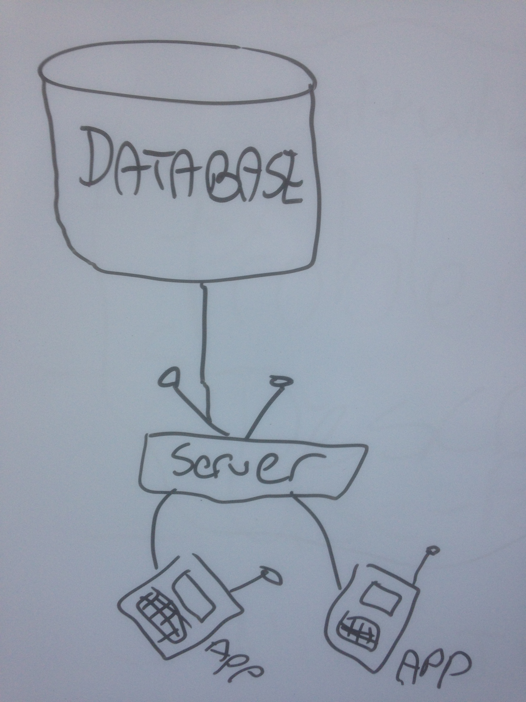
Design
Database → Server → Multiple App Instances

Slide 6
Data Sets - Classes
Person
Student
Employee (Subs: Prof, Admin)
Course
Section (collection)
Class time (collection)
Permission/Pre-reqs
Enrollment (Linking Person + Classes)
Department
List of Courses (collection)
Dept Code (CMPT)
Room Number
List of Employees (collection)

Slide 7
Data Sets – Person Attributes
ID
Name(first, middle, last, preferred)
email
netID
gender
birthday
phone number
address (broken up into further details)
passwords (hashed + salt)
creation date
last modification date

Slide 8
Data Sets – Course Attributes
ID
Title (e.g. CMPT305)
Description
Career (certificate, diploma, ugrad, grad, phd)
Sections (collection)
Term

Slide 9
Data Sets – Section Attributes
ID
Type (LAB, SEM, LEC)
Permissions – prereqs, overrides
Time (start, end, days)

Slide 10
Data Sets – Employee Attributes
ID
SIN
Salary
Dept Code
Role
Sections(collection)

Slide 11
Data Sets – Department
List of Courses (collection)
Dept Code (ie. CMPT)
Room Number
List of Employees (collection)

Slide 12
Libraries
Database Connector
REST framework
Android GUI (graphics)

Slide 13
Timetable - Tasks
Web Server (David)
communicate with database (CRUD app)
Database (John + David)
tables
queries
adding/removing entries
App (Dylan + Cody)
super classes
very basic interface
local database copy
methods
parsing json

Slide 14
Timetable – Schedule
October 20
Database Schema Done
ER Diagram
Super-Classes
October 27th
Basic GUI
Web Server Running
November 3rd
Course Searching
November 10th
More Functionality (elements, etc.)
November 17th
More Functionality (elements, etc.)
November 24th
Completion (Tweaking Stages)
December 1st
Due Date (6 weeks total work time)

